Slide 1
Analysis of Zodiac Data
By:
Ryan D’souza

Slide 2
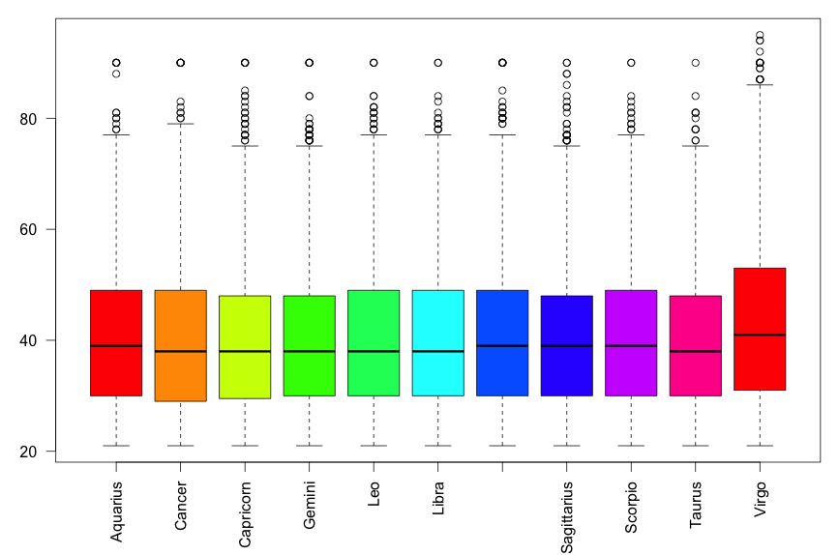
Age versus Zodiac Symbol

Slide 3
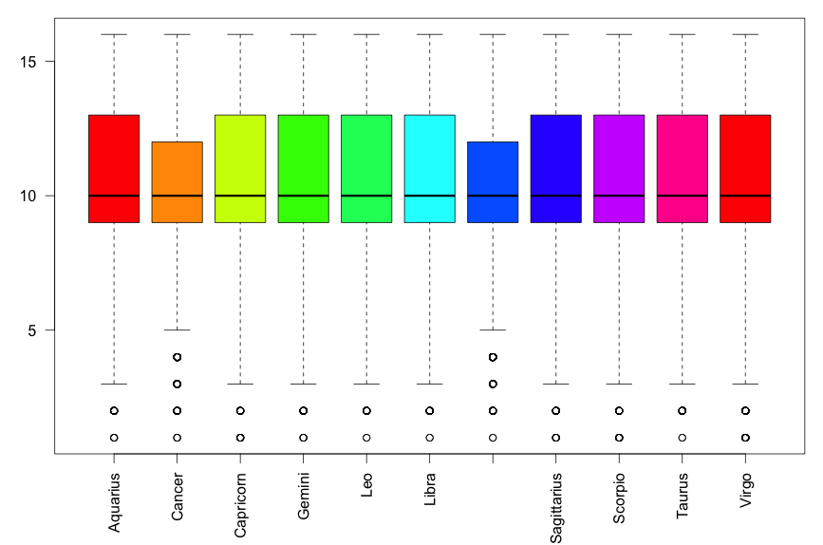
Years vs Zodiac Symbol

Slide 4
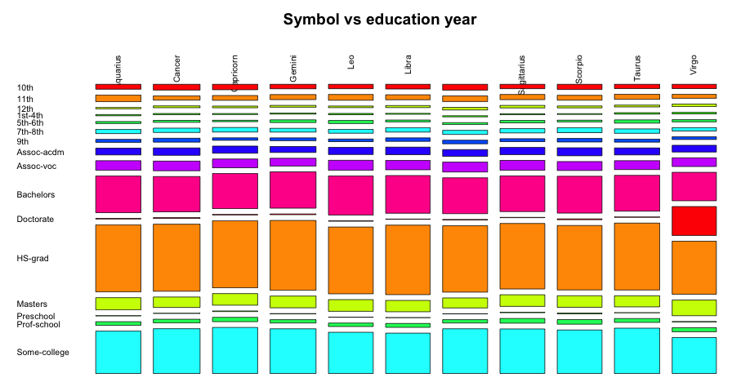
Symbol vs Education

